Slide 1


EDA Project
Deck Components
A Complete Guide to Building Your Presentation Deck

Slide 2



1
Cover Page
What to Include
• Project title
• Team member(s) name
• Organization if exist
• Date
Why It Matters
Sets context and professionalism.
Creates first impression and establishes credibility.

Slide 3
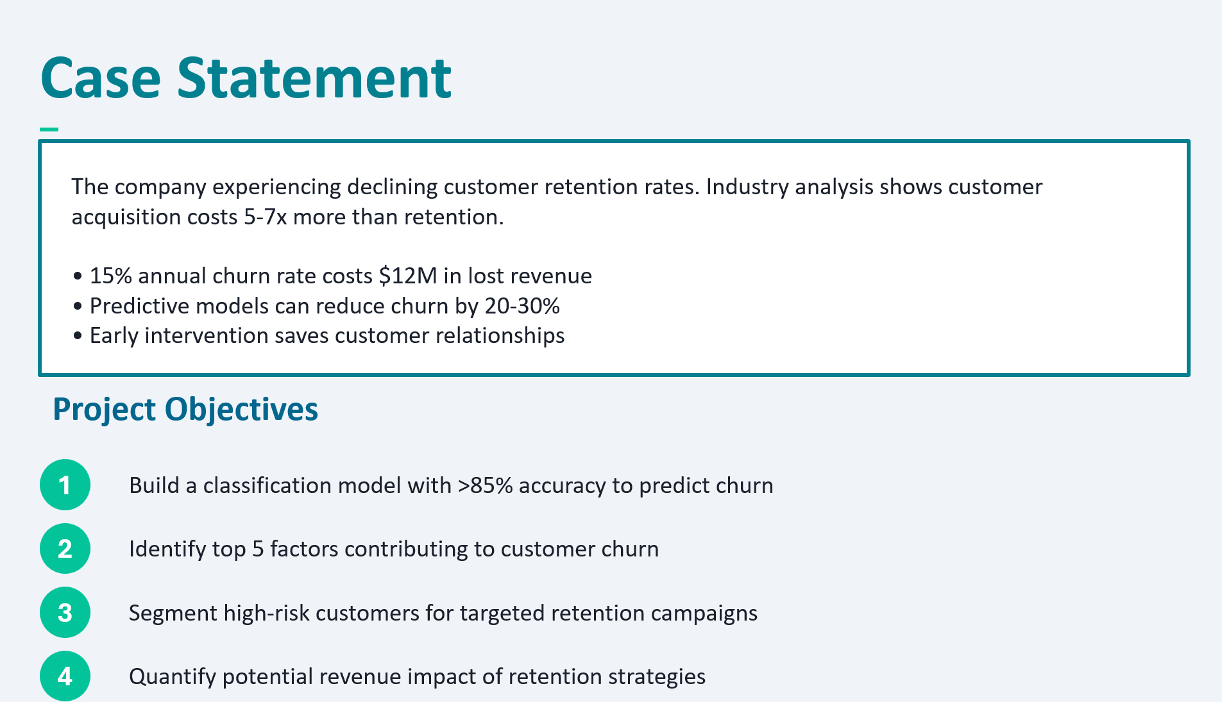


2
Problem Statement
What to Include
Clear problem statement or business question
Objectives of the analysis
Why It Matters
Defines what problem you are solving and why
Provides focus and direction

Slide 4


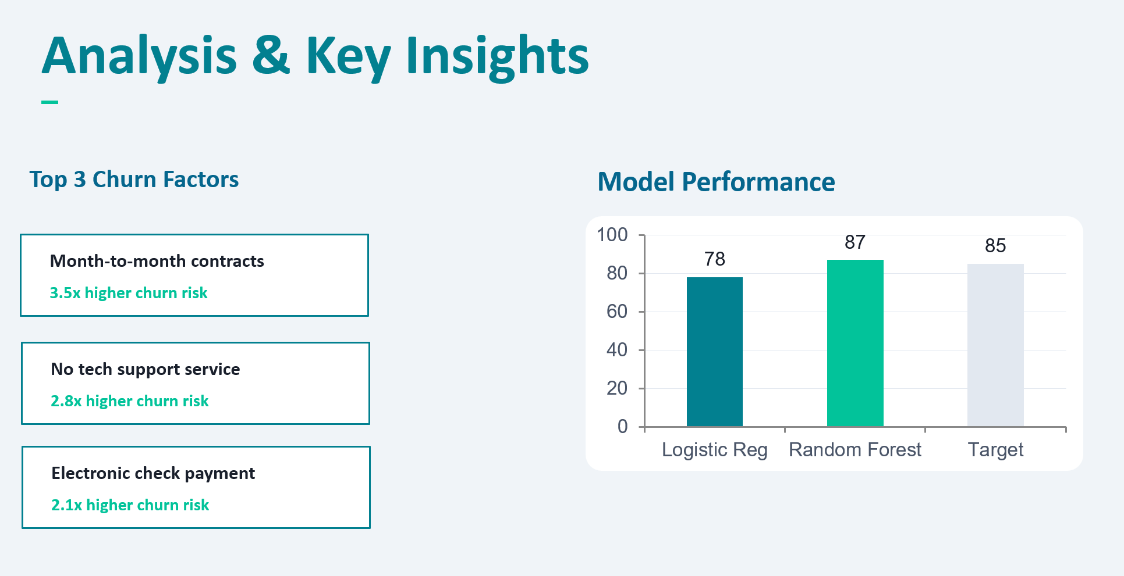

3
Analysis
Core Work
5 slides minimum
Evidence & Insights
What to Include
Methods used (EDA, statistics, modeling, trends)
Key insights and patterns discovered
Why It Matters
The core analytics work and evidence
Provides substance and credibility

Slide 5
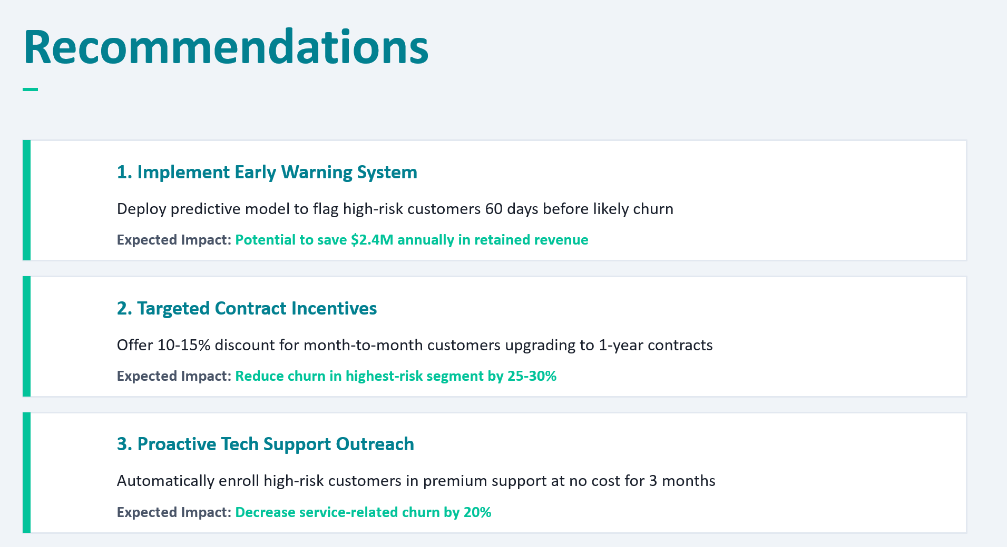


4
Recommendation
What to Include
Actionable, data-driven suggestions
Business impact of the recommendations
Why It Matters
Turns insights into decisions
Drives action and implementation

Slide 6
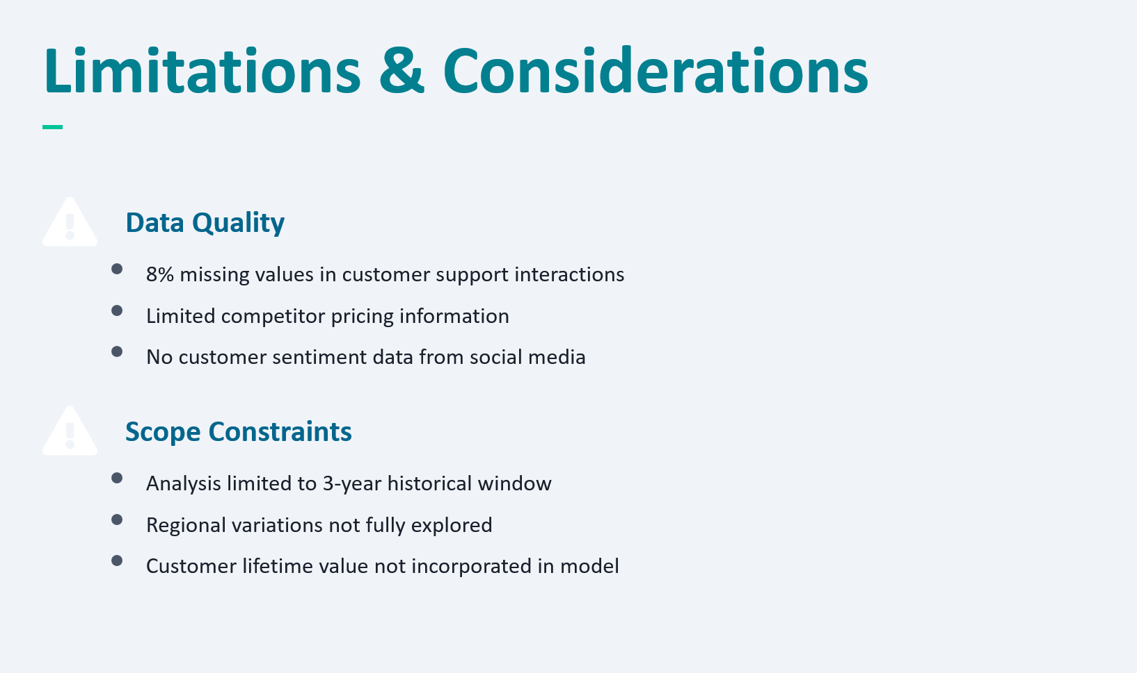


5
Limitation
What to Include
Assumptions and constraints
Data quality issues
What could not be analyzed
Why It Matters
Demonstrates analytical maturity and transparency
Builds trust and credibility

